Slide 1
DESIGN PATTERNS
BRIDGE DESIGN PATTERN

Slide 2
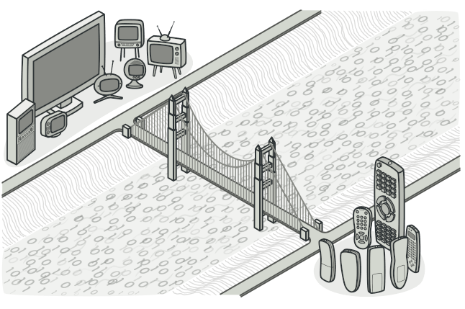
BRIDGE PATTERN
Bridge is a structural design pattern that lets you split a large class or a set of closely related classes into two separate hierarchies—abstraction and implementation—which can be developed independently of each other.

Slide 3
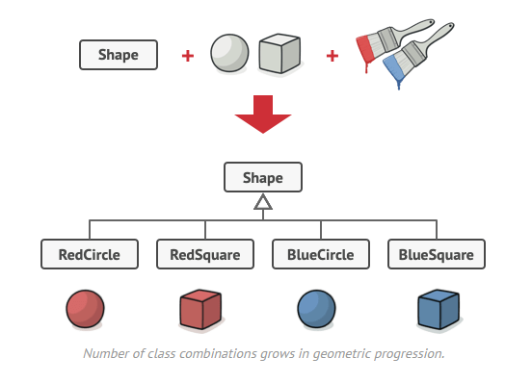
PROBLEM
Say you have a geometric Shape class with a pair of subclasses: Circle and Square. You want to extend this class hierarchy to incorporate colors, so you plan to create Red and Blue shape subclasses. However, since you already have two subclasses, you’ll need to create four class combinations such as BlueCircle and RedSquare.

Slide 4
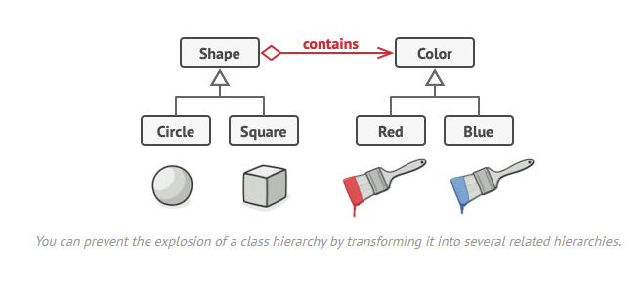
BRIDGE SOLUTION
SOLUTION
This problem occurs because we’re trying to extend the shape classes in two independent dimensions: by form and by color

Slide 5
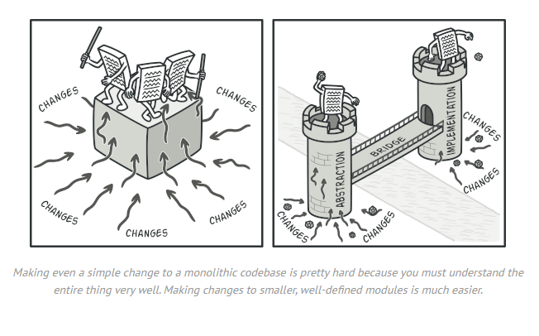
ABSTRACTION AND IMPLEMENTATION
Abstraction (also called interface) is a high-level control layer for some entity. This layer isn’t supposed to do any real work on its own. It should delegate the work to the implementation layer (also called platform).
In real applications, the abstraction can be represented by a graphical user interface (GUI), and the implementation could be the underlying operating system code (API) which the GUI layer calls in response to user interactions.

Slide 6
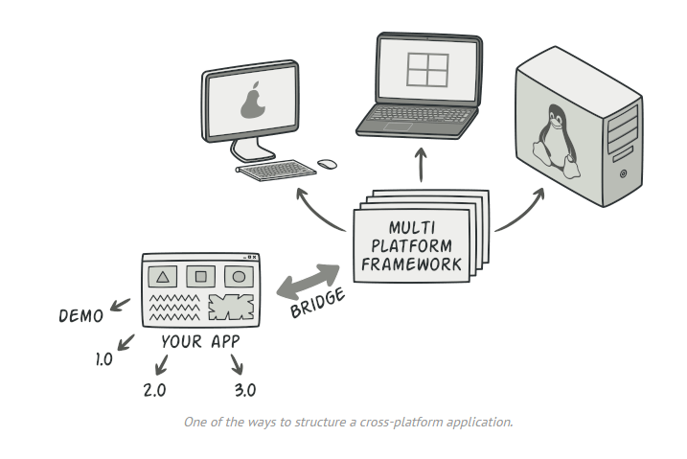
IN REAL LIFE
The abstraction object controls the appearance of the app, delegating the actual work to the linked implementation object. Different implementations are interchangeable as long as they follow a common interface, enabling the same GUI to work under Windows and Linux.

Slide 7
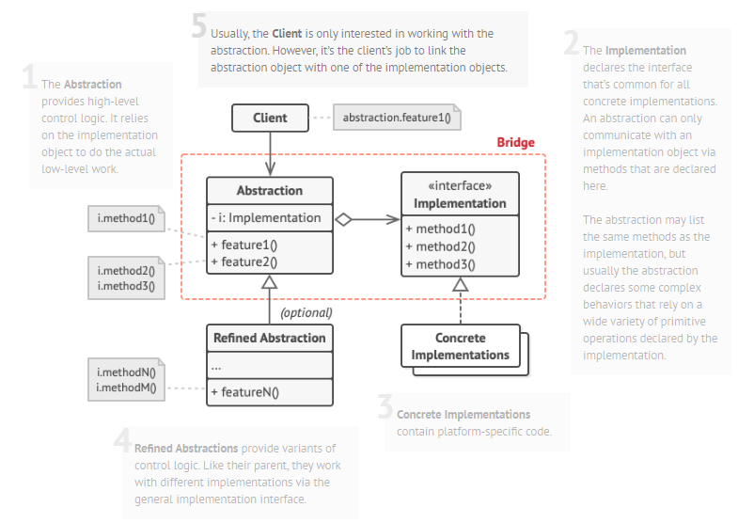
-The Abstraction provides high-level control logic. It relies on the implementation object to do the actual low-level work.
-The Implementation declares the interface that’s common for all concrete implementations. An abstraction can only communicate with an implementation object via methods that are declared here.

Slide 8
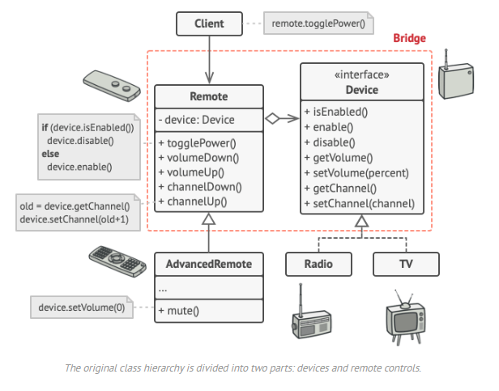
This example illustrates how the Bridge pattern can help divide the monolithic code of an app that manages devices and their remote controls. The Device classes act as the implementation, whereas the Remotes act as the abstraction.

Slide 9
THANKS!
Do you have any questions?
Just Ask
Created By : Abbasov Samir

